Slide 1
Distributed DBMS Reliability
Chapter 12
Distributed DBMS Reliability
Notes:
1

Slide 2
Reliability
Problem
How to maintain
  atomicity
  durability
properties of transactions?

Slide 3
Fundamental Definition - Reliability
A measure of success with which a system conforms to some authoritative specification of its behavior.
Probability that the system has not experienced any failures within a given time period.
Typically used to describe systems that cannot be repaired or where the continuous operation of the system is critical.

Slide 4
Fundamental Definition - Availability
The fraction of the time that a system meets its specification.
The probability that the system is operational at a given time t.

Slide 5
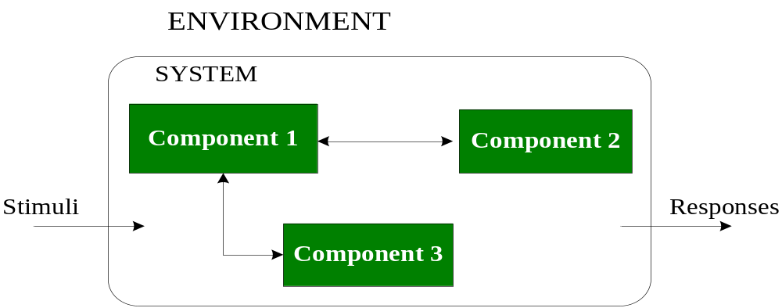
Schematic of a System
External state of a system:
response that the system gives to an external stimulus
Internal state of a system:
union of the external states of the components that make
up the system

Slide 6
From Fault to Failure
causes
results in
Fault
  An error in the internal states of the components of a system or in the design of a system.
Error
  The part of the state which is incorrect.
Erroneous state
  The internal state of a system such that there exist circumstances in which further processing, by the normal algorithms of the system, will lead to a failure which is not attributed to a subsequent fault.
Failure
  The deviation of a system from the behavior that is described in its specification.
Fault
Error
Failure

Slide 7
Types of Faults
Hard faults
  Permanent (reflecting an irreversible change in the behavior of the system)
  Resulting failures are called hard failures
Soft faults
  Transient or intermittent (due to unstable states)
  Resulting failures are called soft failures
  Account for more than 90% of all failures

Slide 8
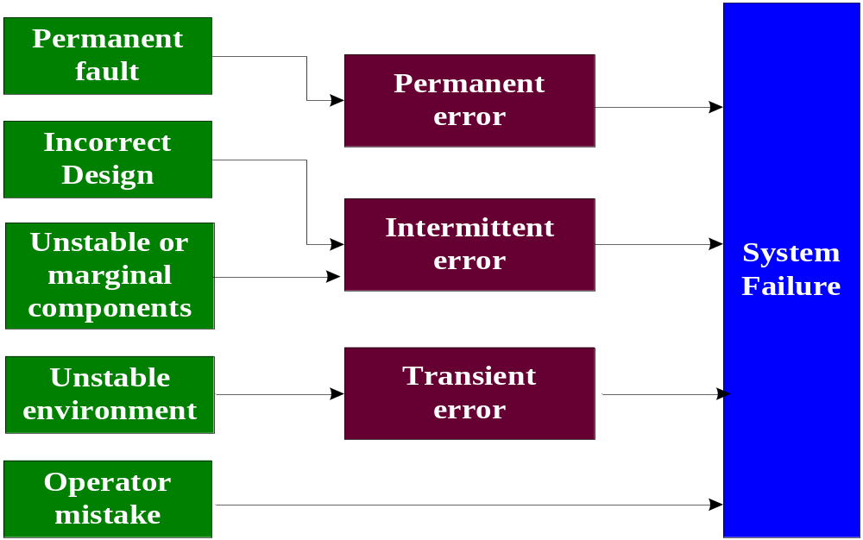
Fault Classification

Slide 9
Failures
MTBF
MTTD
MTTR
Time
Fault
occurs
Error
caused
Detection of error
Fault
occurs
Error
caused
Repair
Multiple errors can occur
during this period.
MTBF: mean time between failures
MTTD: mean time to detect
MTTR: mean time to repair

Slide 10
Types of Failures
Transaction failures
  Transaction aborts (unilaterally or due to deadlock)
  Avg. 3% of transactions abort abnormally
System (site) failures
  Failure of processor, main memory, power supply, ...
  Main memory contents are lost, but secondary storage contents are safe
Media failures
  Failure of secondary storage devices such that the stored data is lost
  Head crash/controller failure
Communication failures
  Lost/undeliverable messages
  Network partitioning

Slide 11
Local Reliability Protocols
LRM (Local Recovery Manager) maintains the atomicity and durability properties of local transactions by performing some functions.
Accepted commands
  begin_transaction
  read / write
  commit / abort
  recover

Slide 12
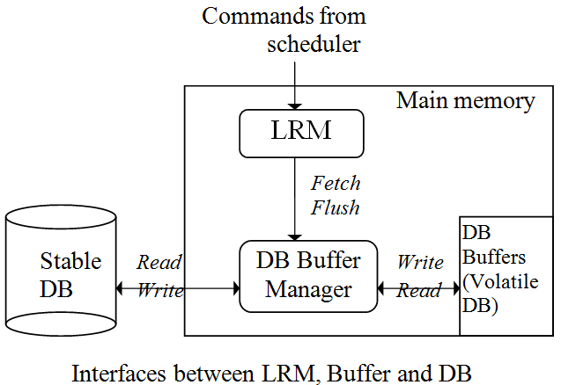
Architecture
LRM executes operations only on the volatile DB.
Buffers are organized in pages

Slide 13
Volatile vs. Stable Storage
Volatile storage
  Consisting of the main memory of the computer system (RAM).
Stable storage
  Resilient to failures and losing its contents only in the presence of media failures (e.g., head crashes on disks).
  Implemented via a combination of hardware (non-volatile storage) and software (stable-write, stable-read, clean-up) components.

Slide 14
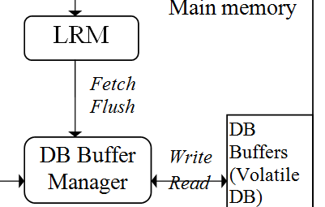
Architectural Considerations
Fetch - Get a page
  if the page is in DB buffers, then the Buffer Manager returns it; otherwise the buffer Manager reads it from the Stable DB and puts it in buffers.
  Buffers full (?)
Flush - Write pages
  force pages to be written from buffers to the stable DB.

Slide 15
Recovery Information
In-place update
  Physically change the value of data items in stable DB. The previous values are lost.
Out-of-place update
  Do not change the value of data items in stable DB but maintain the new value separately.
Most DBMSs use in-place update for better performance.

Slide 16
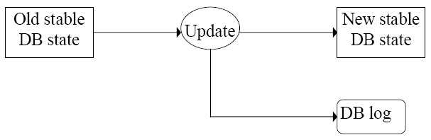
In-Place Update Recovery Information
Recovery information are kept in DB log. Each update not only changes DB, but also saves records in DB log.
Database Log
Every action of a transaction must not only perform the action, but also write a log record to an append-only file.

Slide 17
Logging
The log contains information used by the recovery process to restore the consistency of a system.
This information may include
  transaction identifier
  type of operation (action)
  items accessed by the transaction to perform the action
  old value (state) of item (before image)
  new value (state) of item (after image), etc.

Slide 18
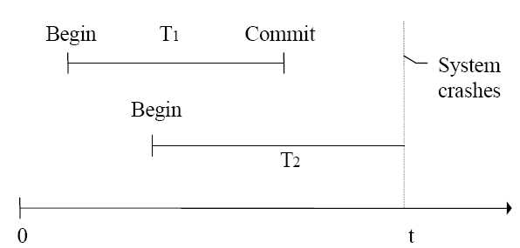
Why Logging?
Assume buffer pages are written back to stable DB only when Buffer Manager needs new buffer space.
T1: from user’s viewpoint, it is committed. But updated buffer pages may get lost. Redo is needed.
T2: not terminated, but some updated pages may have been written to stable DB. Undo is needed.

Slide 19
Failure Recovery
If a system crashes before a transaction is committed, then all the operations must be undone. Only need the before images (undo portion of the log).
Once a transaction is committed, some of its actions might have to be redone. Need the after images (redo portion of the log).

Slide 20
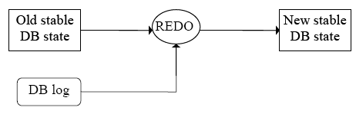
REDO Protocol
Redo T1
REDO an action means performing it again.
The REDO operation uses the log information and performs the action that might have been done before, or not done due to failures.
The REDO operation generates the new image.

Slide 21
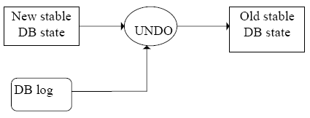
UNDO Protocol
Undo T2
UNDO an action means to restore the object to its before image.
The UNDO operation uses the log information and restores the old value of the object.

Slide 22
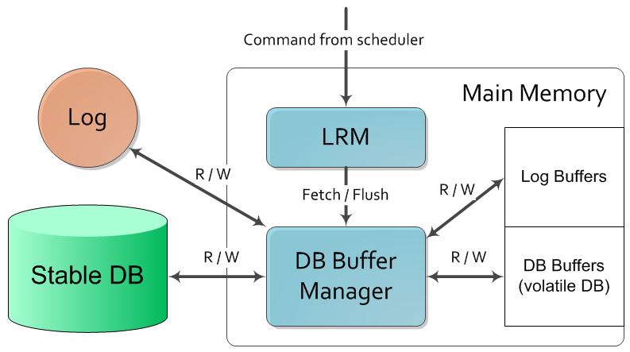
Log File Maintenance
Interfaces between LRM, Buffer, Stable DB and Log file

Slide 23
When to Write Log Records Into Stable Store ?
Assume a transaction T updates a page P
Fortunate case
  System writes P in stable database
  System updates stable log for this update
  SYSTEM FAILURE OCCURS!... (before T commits)
We can recover (undo) by restoring P to its old state by using the log

Slide 24
When to Write Log Records Into Stable Store ? (cont.)
Assume a transaction T updates a page P
Unfortunate case
  System writes P in stable database
  SYSTEM FAILURE OCCURS!... (before stable log is updated)
We cannot recover from this failure because there is no log record to restore the old value.
Solution:
  Write-Ahead Log (WAL) protocol

Slide 25
Write-Ahead Log (WAL) Protocol
Before the stable DB is updated, the before-image should be stored in the stable log. This facilitates UNDO.
When a transaction commits, the after- images have to be written in the stable log prior to the updating of the stable DB. This facilitates REDO.

Slide 26
Log File Maintenance
Two ways to write log pages
  Synchronous (forcing a log) – adding of each log record requires that the log be moved from main memory to the stable storage.
  Asynchronous – the log is moved to stable storage either periodically or when the buffer fills up.
It's relatively easy to recover to a consistent state, but causes delay to the response time.

Slide 27
Out-of-Place Update Recovery Information - Shadowing
When an update occurs, don't change the old page, but create a shadow page with the new values and write it into the stable database.
Update the access paths so that subsequent accesses are to the new shadow page.
The old page retained for recovery.

Slide 28
Out-of-Place Update Recovery Information - Differential files
For each file F, maintain
  a read only part FR
  a differential file consisting of insertions part DF+ and deletions part DF-
  Thus, F = (FR ∪ DF+) – DF-
Updates treated as delete old value, insert new value

Slide 29
LRM Commands
begin_transaction
read
write
abort
commit
recover
Independent of execution
strategy for LRM

Slide 30
Command “begin_transaction”
LRM writes a begin_transaction record in the log
  This write may be delayed until first write command to reduce I/O.

Slide 31
Command “read(a data item)”
LRM tries to read the data item from the buffer. If the data is not in the buffer, LRM issues a fetch command.
LRM returns the data to scheduler.

Slide 32
Command “write(a data item)”
If the data is in buffer, then update it; otherwise issue a fetch command to bring the data to the buffer first and then update it.
Record before-image and after-image in the log.
Inform the scheduler the write has been completed.

Slide 33
Execution Strategies for “commit, abort, recover” Commands
Dependent upon
  Whether the buffer manager may write the buffer pages updated by a transaction into stable storage during the execution of that transaction, or it waits for the LRM to instruct it to write them back?
    no-fix/fix decision
  Whether the buffer manager will be forced to flush the buffer pages updated by a transaction into stable storage at the end (commit point) of that transaction, or the buffer manager flushes them out whenever it needs to according to its buffer management algorithm?
    no-flush/flush decision

Slide 34
Possible Execution Strategies for “commit, abort, recover” Commands
no-fix/no-flush
no-fix/flush
fix/no-flush
fix/flush

Slide 35
No-Fix / No-Flush
Updated data may/may not be written to stable storage before commit.
“Abort” command
  Buffer manager may have written some of the updated pages into the stable database.
  LRM performs transaction undo (or partial undo)
“Commit” command
  LRM writes an “end_of_transaction” record into the log.
Notes:
Fix (not writing stable DB, only LRM makes a mark on updated pages)
Flush (only LRM explicitly commands to write stable DB when commit)

Slide 36
No-Fix / No-Flush (cont.)
Updated data may/may not be written to stable storage before commit.
“Recover” command
  For those transactions that have both a “begin_transaction” and an “end_of_transaction” record in the log, a partial redo is initiated by LRM.
  For those transactions that only have a “begin_transaction” in the log, a global undo is executed by LRM.

Slide 37
No-Fix / Flush
Updated data may/may not be written to stable storage before commit.
“Abort” command
  Buffer manager may have written some of the updated pages into stable database
  LRM performs transaction undo (or partial undo)
“Commit” command
  LRM issues a flush command to the buffer manager for all updated pages
  LRM writes an “end_of_transaction” record into the log.

Slide 38
No-Fix / Flush (cont.)
“Recover” command
  For those transactions that have both a
  “begin_transaction” and an “end_of_transaction” record in the log, no need to perform redo.
  (since already flushed as instructed by LRM)
  For those transactions that only have a “begin_transaction” in the log, a global undo is executed by LRM.

Slide 39
Fix / No-Flush
“Abort” command
  None of the updated pages have been written into stable database
  Release the fixed pages
“Commit” command
  LRM writes an “end_of_transaction” record into the log.
  LRM sends an unfix command to the buffer manager for all pages that were previously fixed

Slide 40
Fix / No-Flush (cont.)
“Recover” command
  For those transactions that have both a
  “begin_transaction” and an “end_of_transaction” record in the log, perform partial redo.
  For those transactions that only have a “begin_transaction” in the log, no need to perform global undo

Slide 41
Fix / Flush
“Abort” command
  None of the updated pages have been written into stable database
  Release the fixed pages
“Commit” command
(the following have to be done atomically)
  LRM issues a flush command to the buffer manager for all updated pages
  LRM sends an unfix command to the buffer manager for all pages that were previously fixed
  LRM writes an “end_of_transaction” record into the log.

Slide 42
Fix / Flush (cont.)
“Recover” command
  For those transactions that have both a
  “begin_transaction” and an “end_of_transaction”
  record in the log, no need to perform partial redo.
  For those transactions that only have a “begin_transaction” in the log, no need to perform global undo

Slide 43
Checkpointing
Simplify the task of determining actions of transactions that need to be undone or redone when a failure occurs.
Avoid the search of the entire log when recovery process is required.
  The overhead can be reduced if it is possible to build a “wall” which signifies that the database at that point is up-to-date and consistent.
The process of building the “wall” is called checkpointing.

Slide 44
A Transaction-Consistent Checkpointing Implementation
First write the begin-checkpoint record in the log and stop accepting new transactions;
Complete all active transactions and flush
all updated pages to the stable DB;
Write an end-of-checkpoint record in the log.

Slide 45
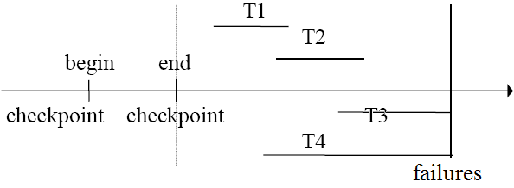
Recovery Based on Checkpointing
Redo by starting from the latest end-of-checkpoint. The sequence is T1, T2. Stop at the end of log.
Undo by starting from the latest end-of-log. The sequence is T3, T4 (reverse order).

Slide 46
Coordinator vs. Participant Processes
At the originating site of a transaction, there is a process that executes its operations. This process is called coordinator process.
The coordinator communicates with participant processes at the other sites which assist in the execution of the transaction’s operations.

Slide 47
Distributed Reliability Protocols
The protocols address the distributed execution of the following commands
  begin-transaction
  read
  write
  abort
  commit
  recover

Slide 48
Distributed Reliability Protocols (cont.)
“begin-transaction”
  (the same as the centralized case at the originating site)
  execute bookkeep function
  write a begin_transaction record in the log
“read” and “write” are executed according to ROWA (Read One Write All) rule.
Abort, commit, and recover are specific in the distribution case.
Notes:
Coordinator process:
write global begin-transaction, abort/commit in log.
Participant process(es):
write local ready, abort/commit in log.

Slide 49
Three Components of Distributed Reliability Protocols
1) Commit protocols
(different from centralized DB)
  How to execute commit command when more than one site are involved?
  Issue: how to ensure atomicity and durability?

Slide 50
Three Components of Distributed Reliability Protocols (cont.)
2) Termination protocols
  If a failure occurs, how can the remaining operational sites deal with it?
  Non­blocking: the occurrence of failures should not force the sites to wait until the failure is repaired to terminate the transactions.

Slide 51
Three Components of Distributed Reliability Protocols (cont.)
3) Recover protocols
(opposite to the termination protocols)
  When a failure occurs, how does the site where the failure occurred to recover its state once the site is restarted?
  Independent : a failed site can determine the outcome of a transaction without having to obtain remote information.
Independent recovery ➔ non­blocking termination

Slide 52
Two-Phase Commit Protocol
Global Commit Rule
  The coordinator aborts a transaction if and only if at least one participant votes to abort it.
  The coordinator commits a transaction if and only if all of
  the participants vote to commit it.
2PC ensures the atomic commitment of a distributed transaction.

Slide 53
Phase 1
The coordinator gets the participants ready to write the results into the database
  The coordinator sends a message to all participants, asking if they are ready to commit, and
  every participant answers “yes” if it's ready or “no” according to its own condition.

Slide 54
Phase 2
Everybody writes the results into the database
  The coordinator makes the final decision - global commit if all participants answer “yes” in phase 1; or global abort, otherwise.
  It then informs all the participants its final decision.
  All participants take actions accordingly.

Slide 55
Coordinator
Participant
INITIAL
1. Unilateral abort
INITIAL
Ready to commit?
PREPARE
Write begin-commit
in log
Write abort in log
No
Vote: ABORT
WAIT
ABORT
Yes
Vote: COMMIT
Write ready in log
Any No?
Yes
Yes
Write abort in log
GLOBAL-ABORT
READY
1
Type of msg?
No
No
GLOBAL-COMMIT
Abort
Write commit
in log
ACK
Write abort in log
Commit
ABORT
Write commit in log
COMMIT
ACK
ABORT
COMMIT
Write end-of-transaction in log

Slide 56
A Simplified Version of 2PC
Coordinator
Participant
INITIAL
PREPARE
INITIAL
Vote COMMIT/ABORT
WAIT
READY
GLOBAL-COMMIT/ABORT
ACK
ACK
COMMIT
ABORT
ABORT
COMMIT

Slide 57
Observations
A participant can unilaterally abort before giving an affirmative vote.
Once a participant answers "yes", it must prepare for commit and cannot change its vote.
While a participant is READY, it can either abort or commit, depending on the decision from the coordinator.
The global termination is commit if all participants vote "yes", or abort if any participant votes "no”.
The coordinator and participants may be in some waiting state, time-out method can be used to exit.

Slide 58
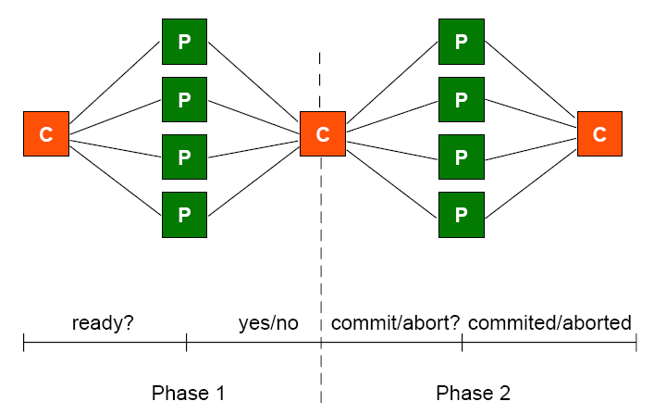
Centralized 2PC
no communication between participants

Slide 59
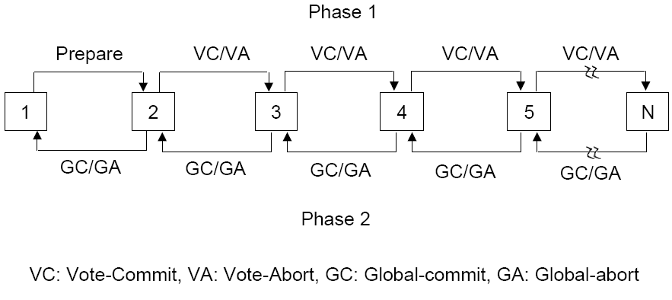
Linear 2PC
Participants communicate with one another.
N participants are ordered from 1 (the coordinator) to N.
Communications during the first phase is in forward fashion from 1 to N and in backward fashion during the second phase.
Fewer messages but no parallelism

Slide 60
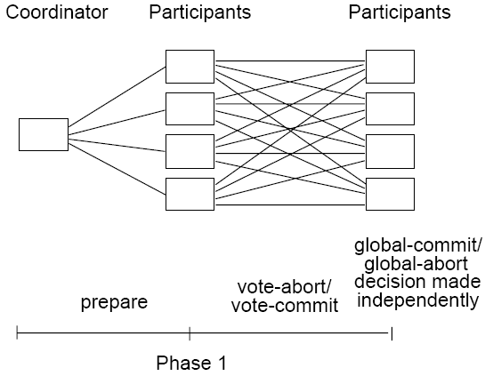
Distributed 2PC
Each participant broadcast its vote to all participants.
No need for the second phase (no ACK message is needed).
Each participant needs to know all other participants.

Slide 61
Variants of 2PC
Shortcomings of 2PC
  Number of messages is big
  Number of log-writing times is big
Two variants of 2PC are proposed to improve performance
  presumed abort 2PC
  presumed commit 2PC

Slide 62
Presumed Abort 2PC Protocol
Assumption
  When a failed site recovers, the recovery routine will check the log and determine the transaction’s outcome.
  Whenever there is no information about the transaction's outcome (“commit” or “abort”), the outcome is abort.

Slide 63
Presumed Abort 2PC Protocol
In case of “abort” transactions
  The coordinator can forget abort the transaction immediately after it decides to abort it.
    It writes an abort record directly in the log and not expect the participants to acknowledge the abort command.
It saves some message transmission between the coordinator and the participants in case of aborted transactions, and is thus more efficient.

Slide 64
Presumed Abort 2PC Protocol (cont.)
    It does not need to write an end-of-transaction in the log after an abort record.
    It does not have to force the abort record to stable storage.
  The participants also do not need to force the abort record either.
  → Presumed Abort

Slide 65
Presumed Abort 2PC Protocol (cont.)
In case of “commit” transactions
  The same as regular 2PC
  Commits have to be acknowledged (while aborts do not).

Slide 66
Presumed Abort 2PC Protocol (cont.)
When a site fails before receiving the decision and recovers later, it can
  find the "commit" and "end_transaction" in the log of the coordinator, or
  find or may not find the "abort" record in the log of the coordinator
and take the corresponding action.
More efficient for “abort” transactions
  Save some message transmission between the coordinator and the participants

Slide 67
Presumed Commit 2PC Protocol
Assumption
  When a failed site recovers, the recovery routine will check the log and determine the transaction’s outcome.
  No information available to the recovery process from the coordinator is equivalent to a "commit".
Aborts have to be acknowledged, while commits do not.

Slide 68
Presumed Commit 2PC Protocol (cont.)
An exact dual of Presumed Abort 2PC will look like:
  The coordinator forgets about the transaction after it decides to commit.
  The commit record of the coordinator (also the ready record of the participants) needs not be forced.
  The commit
  command needs
  not be acknowledged.
Distributed Database Systems

Slide 69
Presumed Commit 2PC Protocol (cont.)
However, it does not work correctly in the following case.
  The coordinator fails after sending the prepare message for vote-collection, but before collecting all votes from the participants.
  In recovery process:
    The coordinator will undo the transaction since no global agreement had been achieved. But all participants will commit by assumption.
    ➔ causing inconsistency

Slide 70
Presumed Commit 2PC Protocol (cont.)
Correction to overcome the above case
  The coordinator, prior to sending the “prepare” message, force-writes a “collecting” record containing the names of all participants in the log.
  The participants then enter “COLLECTING” state.
  The coordinator then sends the “prepare” message and enters the WAIT state.

Slide 71
Presumed Commit 2PC Protocol (cont.)
  The coordinator decides “global abort” or “global commit”
    If “abort”, the coordinator writes an abort record, enters the ABORT state, and sends a “global-abort” message.
    If “commit”, the coordinator writes a commit record, sends a “global-commit” command, and forgets the transaction.
  When the participants receive a
    “global-abort” message, they write an abort record and acknowledge.
    “global-commit” message, they write a commit record and update the DB.

Slide 72
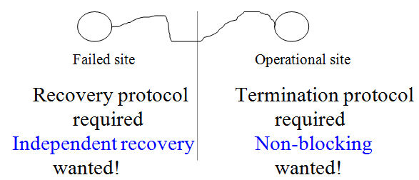
Independent and Non-blocking
Failed site can properly recover without consulting other sites.
Operational site can properly terminate properly without waiting for the recovery of failed site.
Independent recovery and non-blocking protocols exist only for single-site failure, and not possible when multiple sites fail.
2PC is inherently blocking !

Slide 73
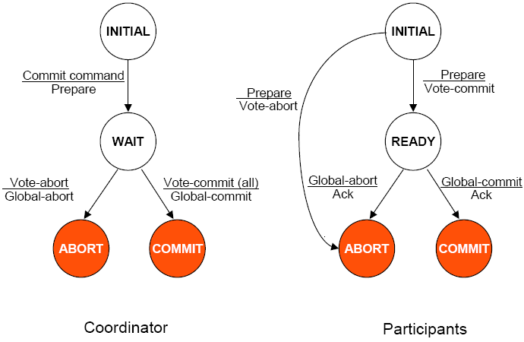
State Transition in 2PC Protocol
Labels on the edge
Top: the reason for the state transition (a received message)
Bottom: the message sent as a result of the state transition

Slide 74
Termination
A timeout occurs at a destination site when it cannot get an expected message from a source site within the expected time period.
Notes:
At the “initial” state timeouts, who cares.

Slide 75
Coordinator Timeouts
The coordinator can time-out in WAIT, ABORT, and COMMIT states.
Coordinator
Participant
INITIAL
PREPARE
INITIAL
Vote COMMIT/ABORT
WAIT
READY
GLOBAL-COMMIT/ABORT
ACK
ACK
COMMIT
ABORT
COMMIT
ABORT
Notes:
At the “initial” state timeouts, who cares.

Slide 76
Coordinator Timeouts (cont.)
“WAIT”
  The coordinator is waiting for the local decisions from the participants.
  Solution: the coordinator
  decides to globally abort the
  transaction by writing an
  abort record in the log,
  and sending a global abort
  to all participants.
Coordinator
INITIAL
Commit command
Prepare
WAIT
Vote Commit (all)
Global-commit
Vote abort (some)
Global-abort

Slide 77
Coordinator Timeouts (cont.)
“COMMIT” or “ABORT”
  The coordinator is not certain if the commit or abort procedures have been completed by all the participants.
  Solution: re-send the
  "global-commit" or
  "global abort" to the
  site that have not
  acknowledged.
  (blocked!)
Coordinator
INITIAL
Commit command
Prepare
WAIT
Vote Commit (all)
Global-commit
Vote abort (some)
Global-abort
COMMIT
ABORT

Slide 78
Participant Timeouts
A participant can time-out in INITIAL or READY states.
Coordinator
Participant
INITIAL
PREPARE
INITIAL
Vote COMMIT/ABORT
WAIT
READY
GLOBAL-COMMIT/ABORT
ACK
COMMIT
ACK
ABORT
ABORT
COMMIT

Slide 79
Participant Timeouts (cont.)
“INITIAL”
  The participant is waiting for a “prepare” message.
  The coordinator must have failed in INITIAL state.
  Solution: the participant unilaterally
  aborts the transaction. If the
  "prepare" message arrives later,
  it can be responded by
    voting abort, or
    just ignoring the message.
    This causes the time-out of the coordinator
    in the WAIT state (abort and re-send global
    abort to participants).
Participants
INITIAL
Prepare
Vote-abort
Prepare
Vote-commit
READY
Global-abort
Ack
Global-commit
Ack
ABORT
COMMIT

Slide 80
Participant Timeouts (cont.)
“READY”
  The participant must have "voted commit" and therefore cannot change it and unilaterally abort it.
  Solution: blocked until it can learn (from the coordinator or other participants) the ultimate fate of the transaction.
Participants
INITIAL
  In centralized communication structure,
  a participant has to ask the coordinator
  for its decision.
  If the coordinator failed, the participant
  will remain blocked.
Prepare
Vote-abort
Prepare
Vote-commit
READY
Global-abort
Ack
Global-commit
Ack
ABORT
COMMIT

Slide 81
Can Blocking Problem be Overcomed?
No!
2PC is an inherently blocking protocol.

Slide 82
Another Distributed Termination Protocol
Assume participants can communicate with each other.
Let Pi be the participant that timeouts in the READY state, and Pj be the participant to be asked.

Slide 83
All the Cases that Pj Can Respond
Pj is in the INITIAL state. This means Pj has not voted yet. Pj can unilaterally abort the transaction and reply to Pi with a “vote-abort” message.
Pj is in the READY state. Pj does not know the global decision and cannot help.
Pj is in COMMIT or ABORT state. Pj can send “global-commit” or “global-abort” to Pi.

Slide 84
How Pi interprets these responses?
Pi receives “vote-abort” from all Pjs. Pi just proceeds to abort the transaction.
Pi receives "vote-abort" from some Pj, but some other participants are in READY state.
Pi goes ahead and aborts the transaction.
Pi receives the information that all Pjs are READY. Pi is blocked, since it has no knowledge about the global decision.

Slide 85
How Pi interprets these responses? (cont.)
Pi receives either “global-abort” or “global-commit” messages from all Pjs. Pi can go ahead and terminate the transaction according to the message.
Pi receives either “global-abort” or “global-commit” messages from some Pj, but others are in READY. Pi takes action same as (4).
These are all the alternatives that the termination protocol needs to handle.

Slide 86
Recovery
A failed coordinator or participant recovers when it restarts.
Assuming
  Writing log and sending messages are assumed as an atomic action;
  The state
  transition occurs
  after message
  sending.
Coordinator
Participant
INITIAL
PREPARE
INITIAL
Vote COMMIT/ABORT
WAIT
GLOBAL-COMMIT/ABORT
READY
ACK
COMMIT
COMMIT
ABORT
ACK
ABORT

Slide 87
Coordinator Site Failure
The coordinator fails while in INITIAL state.
  Action: restart the transaction.
The coordinator fails while in WAIT state.
  Action: restart the commit process by sending the “prepare” message once more.
The coordinator fails while in COMMIT / ABORT state.
  Action: If all ACK messages have been received, then no action is needed; otherwise follow the termination protocols (re-send “global-commit/abort” message to participant sites).

Slide 88
Participant Site Failure
A participant fails while in INITIAL.
  Action: Upon recovery, the participant should abort the transaction unilaterally.
A participant fails while in READY.
  Action: Same as time-out in the READY state and follow its termination protocols (ask for help).
A participant fails while in ABORT/COMMIT.
  Action: No action.

Slide 89
Problem with 2PC
Blocking
  “Ready” implies that the participant waits for the coordinator
  If coordinator fails, site is blocked until recovery
  Blocking reduces availability

Slide 90
Problem with 2PC (cont.)
Independent recovery is not possible
It is known that:
  Independent recovery protocols exist only for single site failures;
  No independent recovery protocol exists which is resilient to multiple-site failures.
So we search for these protocols – 3PC

Slide 91
Three-Phase Commit (3PC)
3PC is non-blocking
A commit protocol is non-blocking iff
  it is synchronous within one state transition, and
  its state transition diagram contains no state which is “adjacent” to both a commit and an abort state, and
  no non-committable state which is “adjacent” to a commit state
“Adjacent” - possible to go from one stat to another with a single state transition

Slide 92
3PC (cont.)
Committable: all sites have voted to commit a transaction
  COMMIT – commitable state
  WAIT, READY – non-commitable state

Slide 93
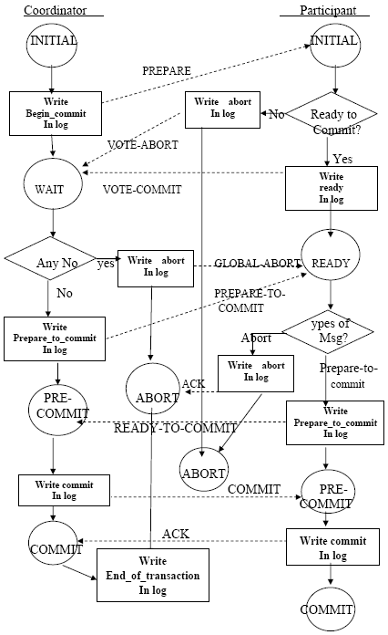
Action Diagram
Add a PRE-COMMIT state between WAIT and COMMIT for coordinator, and
between REDAY and COMMIT for participants.
Distributed Database Systems

Slide 94
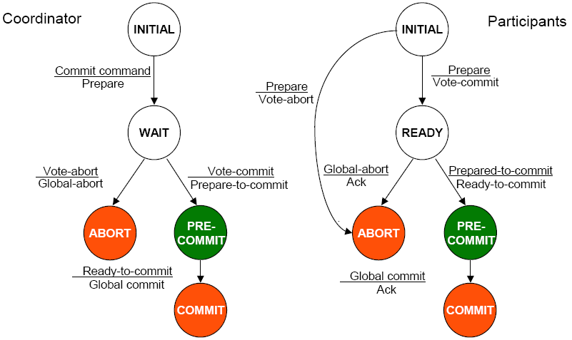
State Transitions of 3PC

Slide 95
State Transitions of 3PC (cont.)
surely abort
surely commit

Slide 96
3PC Termination Protocol
Coordinator timeouts
  In the WAIT state
    Same as in 2PC (The coordinator unilaterally aborts the transaction and send a “global abort” message to all participants).
  In the PRE-COMMIT state
    All participants must at least be in READY state (have voted to commit).
    The coordinator globally commits the transaction and sends “pre-commit” message to all operational participants.
  In the COMMIT (or ABORT) state
    Just ignore and treat the transaction as completed
    Participants are either in PRE-COMMIT or READY state and can follow their termination protocols.

Slide 97
3PC Termination Protocol (cont.)
Participants timeout
  In the INTIAL state
    Same as 2PC (coordinator must have failed, and thus unilaterally aborts the transaction).
  In the READY state
    Have voted to commit, but does not know the coordinator’s global decision.
    Elect a new coordinator and terminate using a special protocol (to be discussed below).
  In the PRE-COMMIT state
    Wait for the "global-commit" message from the coordinator.
    Handle it the same as timeout in READY state (above).

Slide 98
3PC Termination Protocol Upon Coordinator Election
The new elected coordinator can be in WAIT (READ), PRE-COMMIT, COMMIT, or ABORT sate.
The new coordinator then guides the participants towards termination
  If the new coordinator is in WAIT (READ) state
    Participants can be in INITIAL, READY, PRECOMMIT, or ABORT states.
    New coordinator globally aborts the transaction.

Slide 99
3PC Termination Protocol Upon Coordinator Election (cont.)
  If the new coordinator is in PRE-COMMIT state
    Participants can be in READY, PRECOMMIT or COMMIT states.
    The new coordinator globally commits the transaction.
  If the new coordinator is in COMMIT state
    The new coordinator globally commits the transaction
  If the new coordinator is in ABORT state
    The new coordinator globally aborts the transaction

Slide 100
3PC Recovery Protocols
The coordinator fails in WAIT
  This causes participants timeout, which have elected a new coordinator and terminated the transaction
  The new coordinator could be in WAIT or ABORT state, leading to the aborted transaction
  Ask around upon recovery.
The coordinator fails in PRE-COMMIT
  Ask around upon recovery.

Slide 101
3PC Recovery Protocols (cont.)
The coordinator fails in COMMIT or ABORT
  Nothing special if all the acknowledgements have received; otherwise the termination protocol is involved.

Slide 102
3PC Recovery Protocols (cont.)
The participants fail in INITIAL
  unilaterally abort upon recovery
The participants fail in READY
  the coordinator has been informed about the local decision
  upon recovery, ask around
The participants fail in PRECOMMIT
  ask around to determine how the other participants have terminated the transaction
The participants fail in COMMIT or ABORT
  no need to do anything

Slide 103
More about 3PC
Advantage
  Non-blocking
Disadvantages
  Fewer independent recovery cases
  More messages

Slide 104
Network Partitioning
Simple partitioning
  The network is partitioned into two parts.
Multiple partitioning
  More than two parts.

Slide 105
Network Partitioning (cont.)
Formal bounds:
  There exists no non-blocking protocol that is resilient to a network partition if messages are lost when partition occurs.
  There exist non-blocking protocols which are resilient to a single network partition if all undeliverable messages are returned to sender.
  There exists no non-blocking protocol which is resilient to a multiple partition.

Slide 106
Design Decisions
Allow partitions to continue their operations and compromise database consistency;
or
Guarantee the consistency by permitting operations in one partition, while the sites in other partitions remain blocked.

Slide 107
Question & Answer

